Slide 1
Spring Webmvc’s System Architecture
Group4
吳崇維 陳熙 林柏劭 王俊翔 蔡昀達
王郁婷 林慶珠 王廷峻 黃柏諭

Slide 2
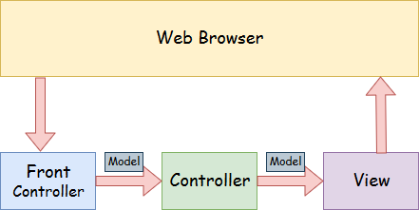

Slide 3
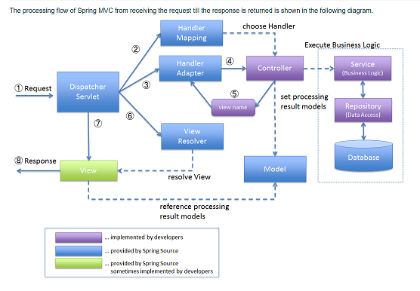

Slide 4
spring mvc
DispatcherServlet
HandlerMapping
HandlerAdapter
ViewResolver

Slide 5
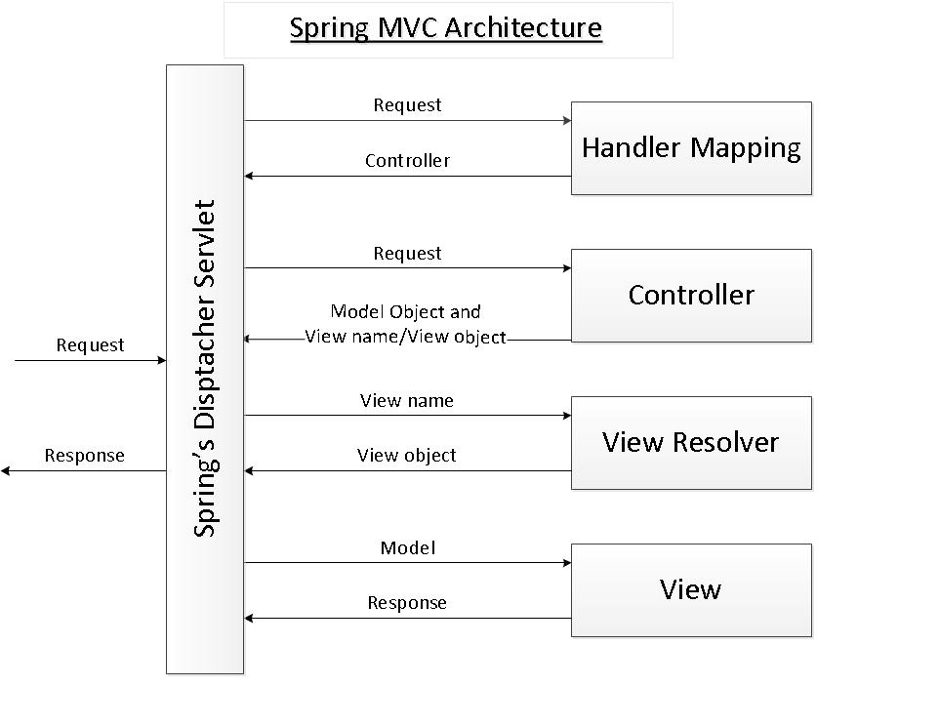
DispatcherServlet
Spring’s front controller. DispatcherServlet handles an incoming HttpRequest, delegates the request, and processes that request according to the configured HandlerAdapter interfaces.

Slide 6
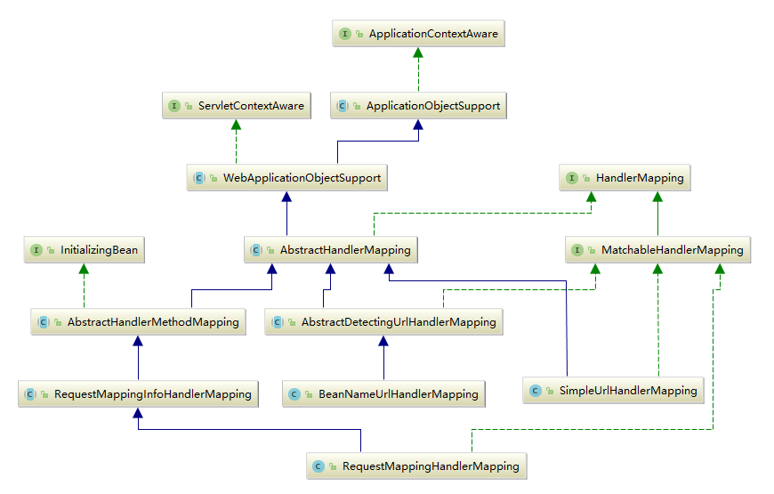
HandlerMapping
Using a handler mapping you can map incoming web requests to appropriate handlers.

Slide 7
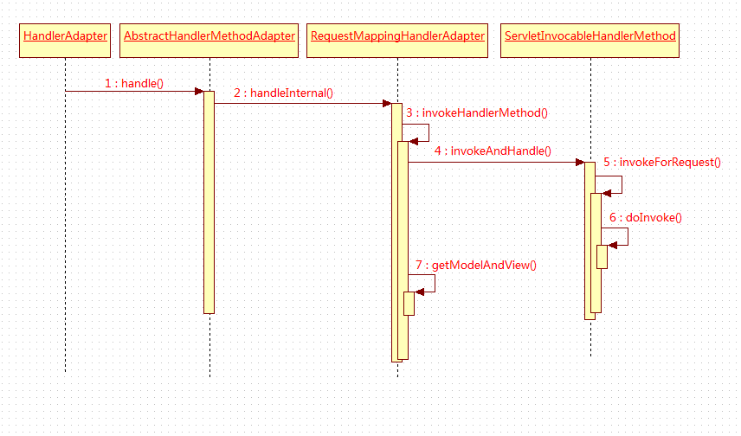
HandlerAdapter
The HandlerAdapter interface facilitates the use of controllers, servlets, HttpRequests, and HTTP paths through several specific interfaces.

Slide 8
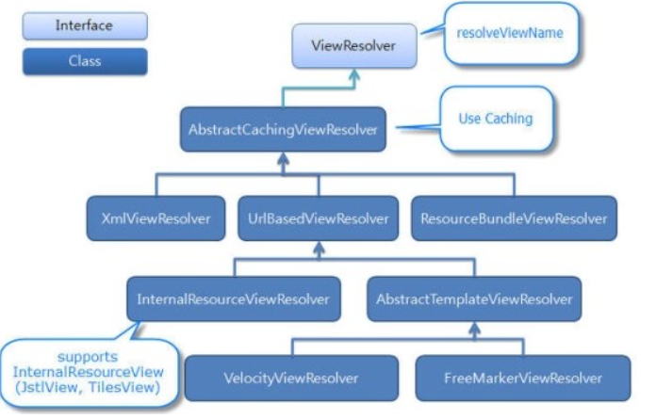
ViewResolver
A ViewResolver determines both what kind of views are served by the dispatcher and from where they are served.

